Slide 1
Identity project
Combined
2019 DMT

Slide 2
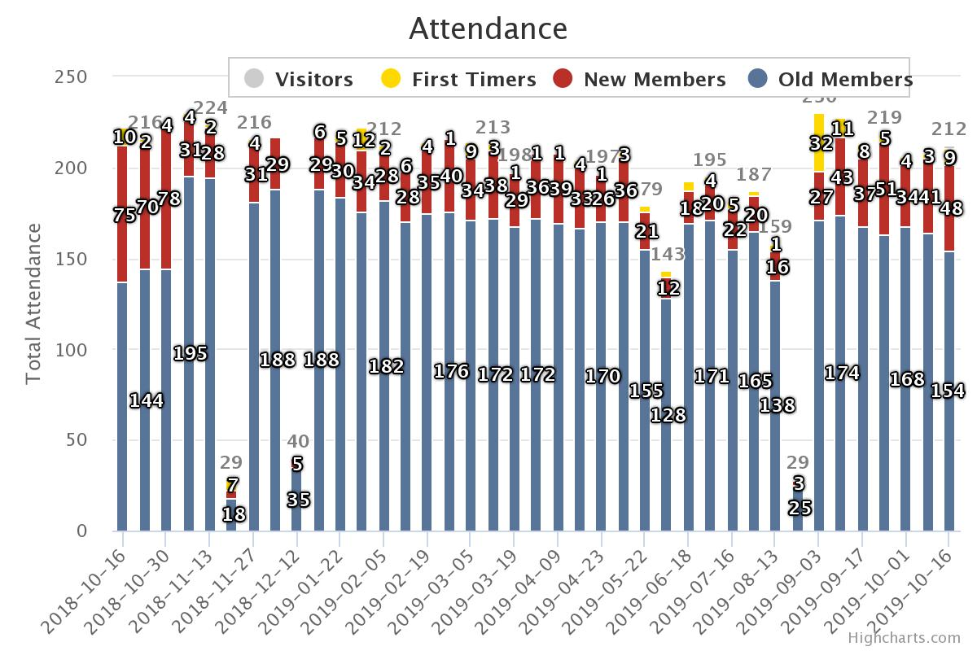

Slide 3
Combined IP Stats since Last DMT
DETAIL | VALUE | DESCRIPTION
Average Attendance: | 194.05 | Average total attendance per meeting for the meetings
Average Attendance Last 4: | 211.25 | Average total attendance per meeting for the last four meetings
Outreach Rate: | 2.49% | Average number of first timers for the last 4 meetings DIVIDED by the average attendance for the last 4 meetings.
Follow-up Ratio: | 1:4.11 | (all first timers - last week ) / (average new members the last 2 weeks). This works best if calculated from the beginning of the church.
Percent Growth: | 8% | The average percentage of the monthly percent growths.
Last 6 Month Growth: | 16.07% | The growth over the last 6 months. (avg of last 4 meeting) - (average of first 4 meetings from 6 months ago) / (average of first 4 meetings from 6 months ago). In the event the church is not six months old we will use the oldest 4 meetings.

Slide 4
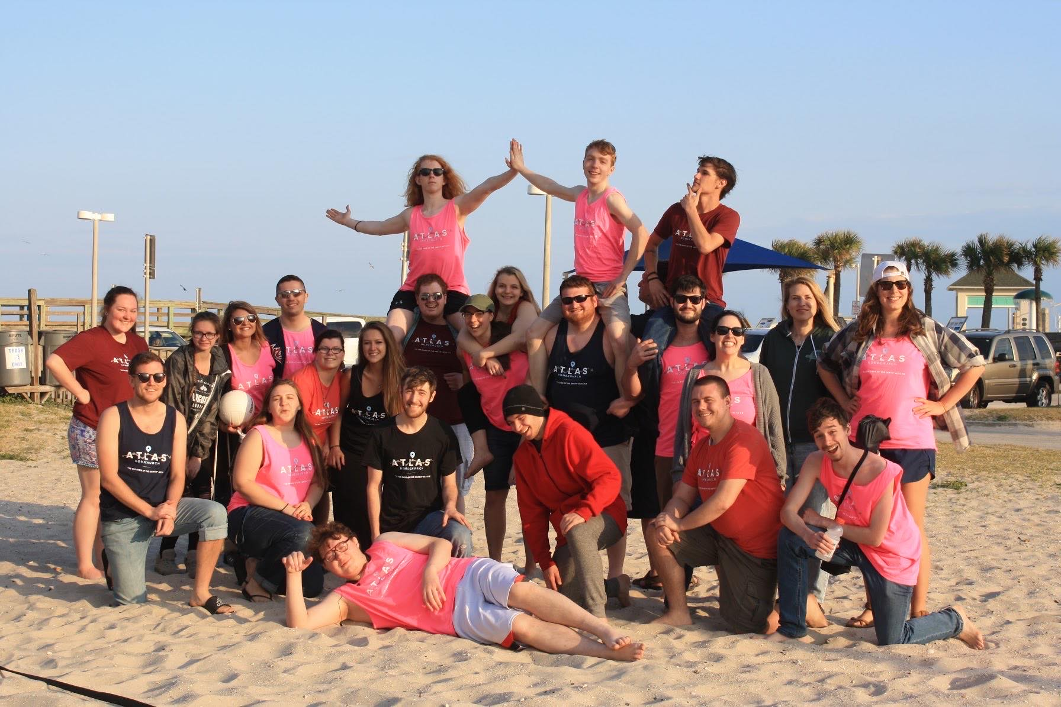
Atlas 2019 DMT

Slide 5
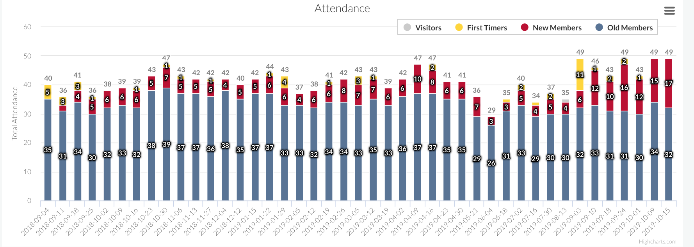
Since Inception (September 2018)

Slide 6
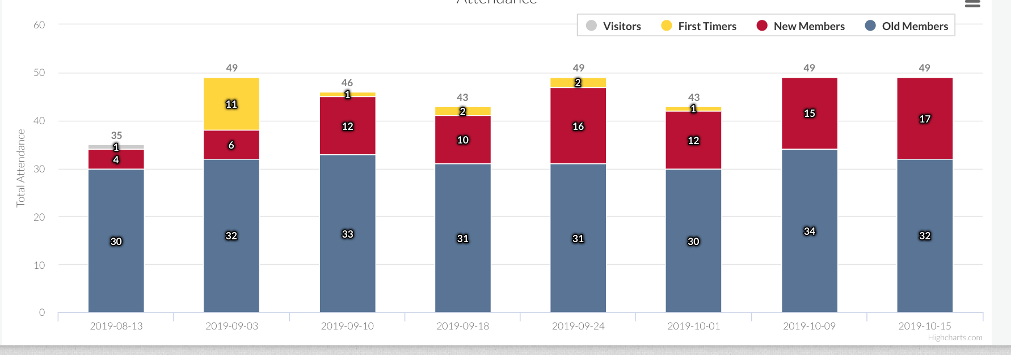
This School Year

Slide 7
Explanation of Statistics
Loss of old members
29% growth rate / over the last 6 months
Outreach: push to get out of the apartments.
Great follow up – first timers come back

Slide 8
Past Year’s Wins & Losses
WINS:
Lot of new ppl this year & they’re coming back
This year, freshman doing better as sophomores
6 salvations since last DMT
New teachers
Relationship maturity
Refinement through loss— resource drains who didn’t want to be there. Freeing, not love sucked out.
LOSSES:
Failure to launch with freshman (They didn’t do outreach or anything at first.)
Suicidal/Depression
People in counseling
Basic Maturity w/ freshmen:
spent lots of time w/ basic maturity / paying rent, holding jobs.

Slide 9
Upcoming challenges
Raising up deacons to split?
How to seal the deal w/ salvations
Career paths for those not in school & disabled
Dealing with counseling/mental illnesses

Slide 10
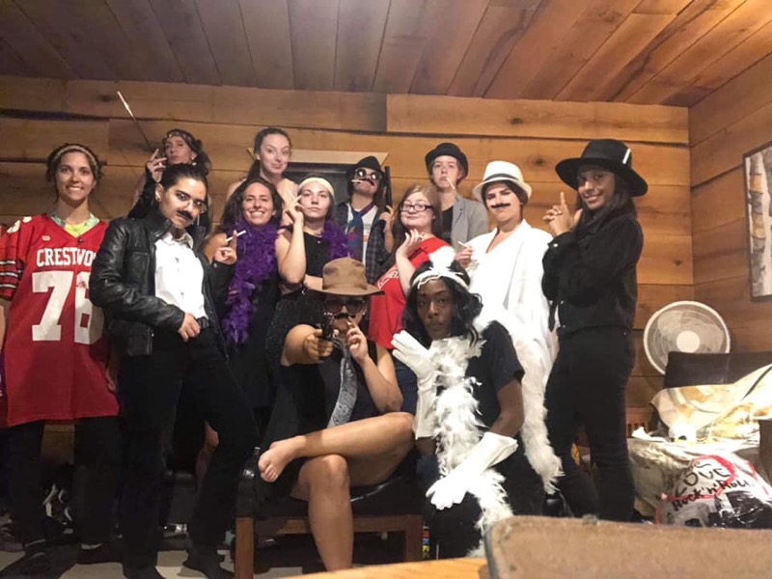
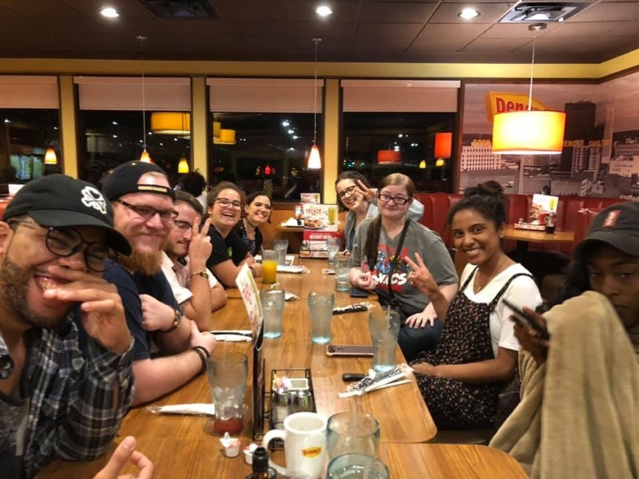
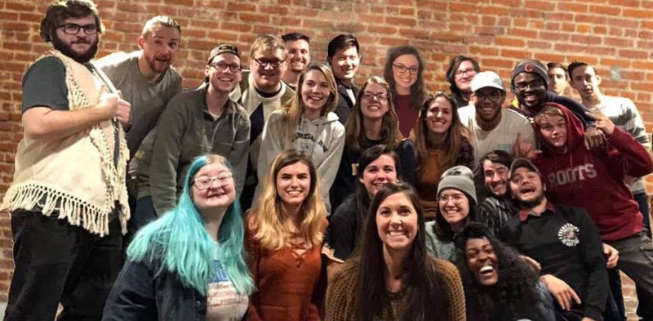
HAM 4.0
“My brothers and sisters, if one of you should wander from the truth and someone should bring that person back, remember this: Whoever turns a sinner from the error of their way will save them from death and cover over a multitude of sins.” James 5:19-20

Slide 11
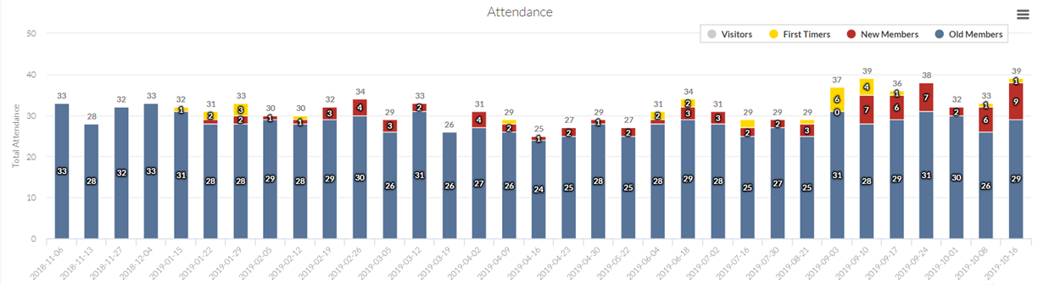
HAM Attendance After NOVA Split (11/06/18)

Slide 12
HAM Attendance Stats After NOVA Split
Average Attendance: 31.55 people Average Attendance Last 4 Meetings: 35.50 people
Outreach Rate: 1.41%
Follow-up Ratio: 1:3.60
Percent Growth Since Split: 2%
Last 6 Month Growth: 24.56%

Slide 13
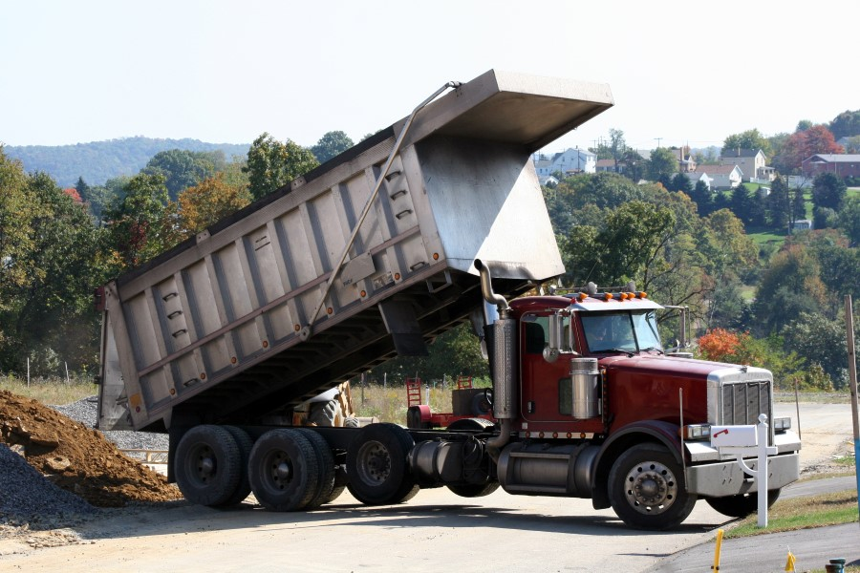
Stats: Dip in summer, but came back strong in the fall
Wins: - Sent off NOVA
- Won and incorporated 3 people
- Overcame disunification between Nitro folks and HAM folks
Losses: - Tom and Kate left fellowship
- Losing 2 other members
Challenges: - Lack of strong teachers
- Raising up the next tier of leadership
Opportunities: - Mullers coming into HAM

Slide 14

3.0

Slide 15
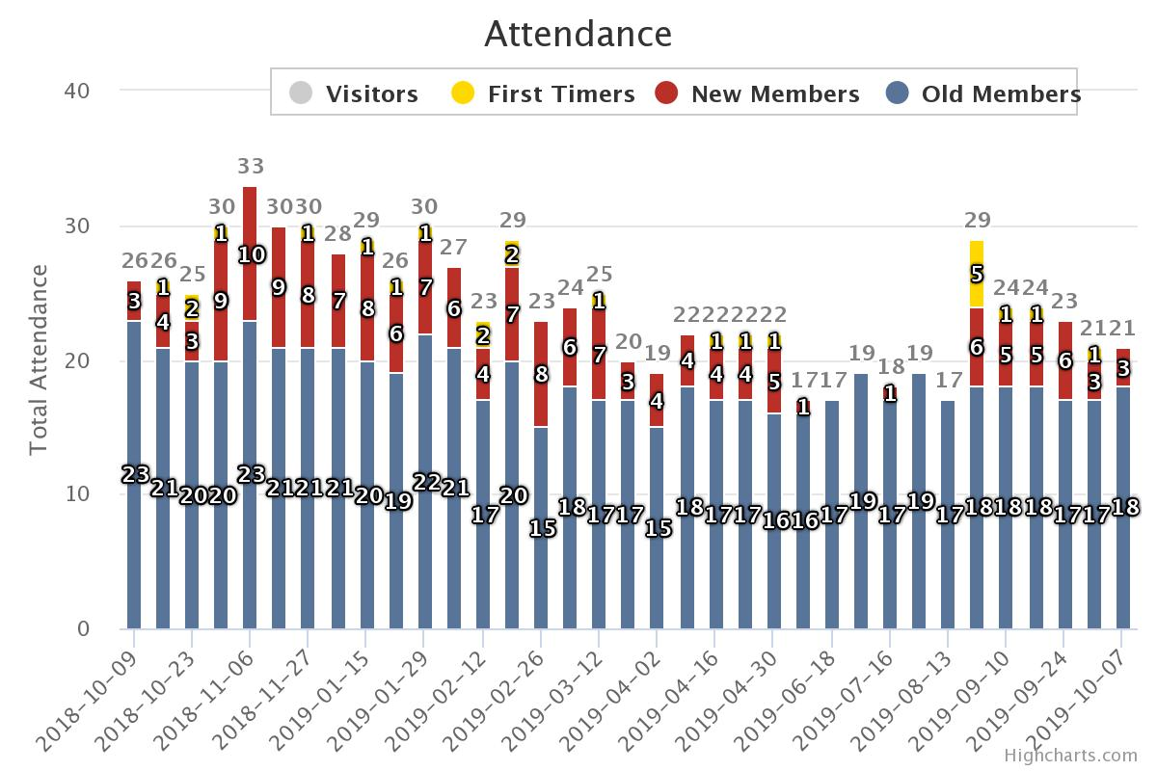
Notes:
Nick, Jeremiah, Brad, Foster, Jamie, Alex
Lost some OT from fall 2018.

Slide 16
Stats
DETAIL | VALUE | DESCRIPTION
Average Attendance: | 24.00 | Average total attendance per meeting for the meetings
Average Attendance Last 4: | 22.25 | Average total attendance per meeting for the last four meetings
Outreach Rate: | 2.25% | Average number of first timers for the last 4 meetings DIVIDED by the average attendance for the last 4 meetings.
Follow-up Ratio: | 1:8.00 | (all first timers - last week ) / (average new members the last 2 weeks). This works best if calculated from the beginning of the church.
Percent Growth: | -1% | The average percentage of the monthly percent growths.
Last 6 Month Growth: | 14.10% | The growth over the last 6 months. (avg of last 4 meeting) - (average of first 4 meetings from 6 months ago) / (average of first 4 meetings from 6 months ago). In the event the church is not six months old we will use the oldest 4 meetings.

Slide 17
Wins/Losses/Challenges
WINS
3 New Cell/Committed Members
1 Salvation
Disciples have Disciples
HC Retreat reinvigorated Ethos
LOSSES
2 people left that were saved
7 New Members don’t come to HC anymore
CHALLENGES
Poor Follow-Up/More Bridges
Fewer Students
Getting certain people to serve

Slide 18

2.0

Slide 19
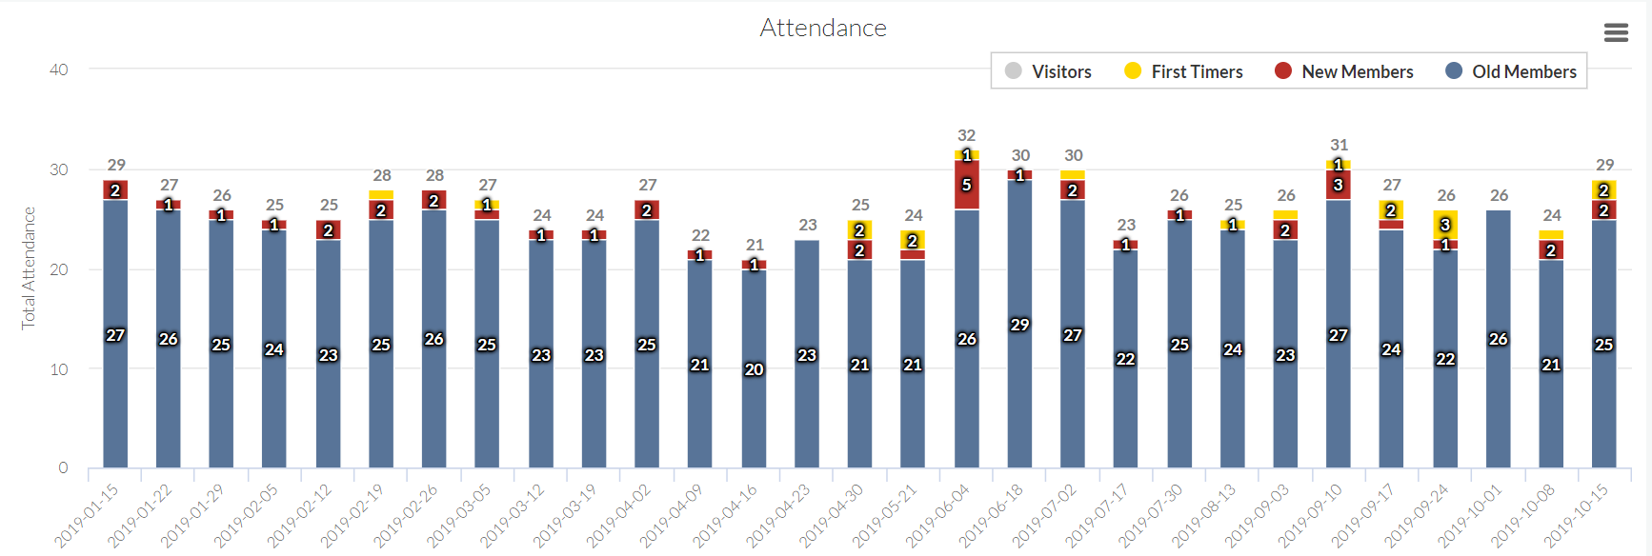
Stats

Slide 20
Explanation of stats
4 people left ministry since last year
2 people left via marriage
Losses replaced by incoming freshmen
First timers almost every meeting since start of school year
Kyle and Caitlin switch off with baby

Slide 21
Wins
New freshmen – with outreach
2 salvations since start of school year
Spawned new ministry
3 new deacon nominations
Losses
Mental illnesses
Older demographic
Flakey old members
Girl outreach

Slide 22
Upcoming challenges
Focus on the college freshmen that are coming
Hit campus events for the women
Incorporate new believers
Support new Hiram plant

Slide 23
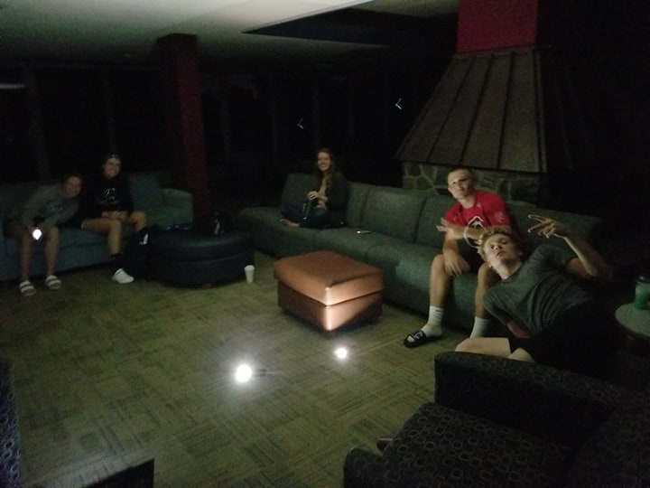
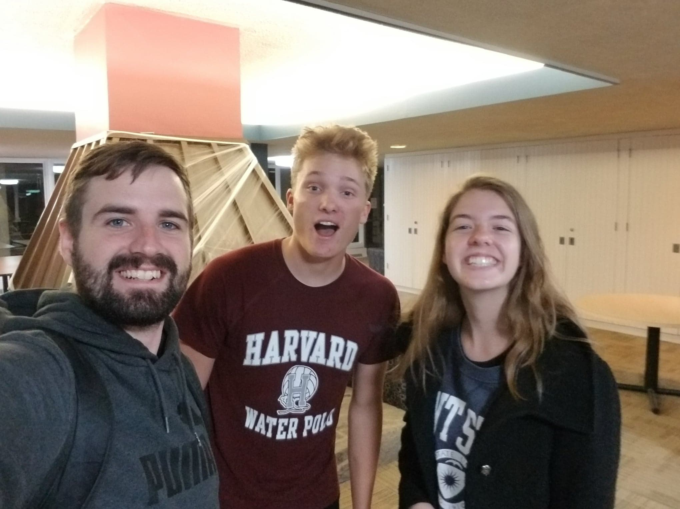
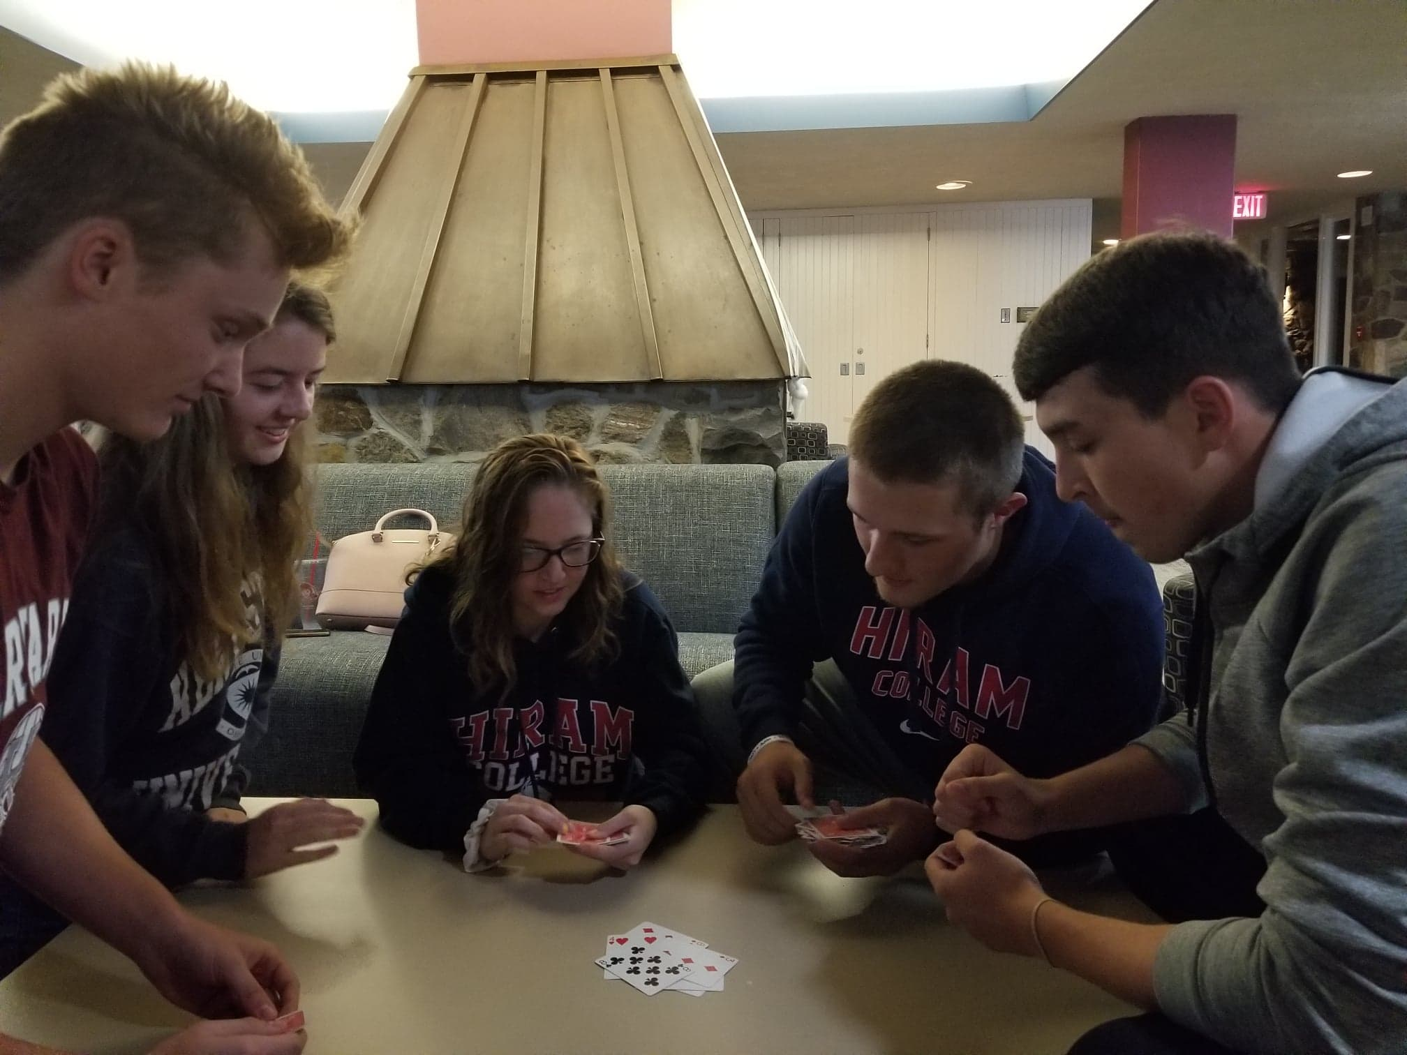
HIP
Hiram Identity Project

Slide 24


Hiram College
1,100 college students (mostly living on campus)
Located 30 minutes away in farm country
1 active Christian student group

Slide 25
HIP
13 first timers
6-7 weekly average attendance
4 meetings
1 discipleship (so far)
Getting ready to transition to Bible Study

Slide 26
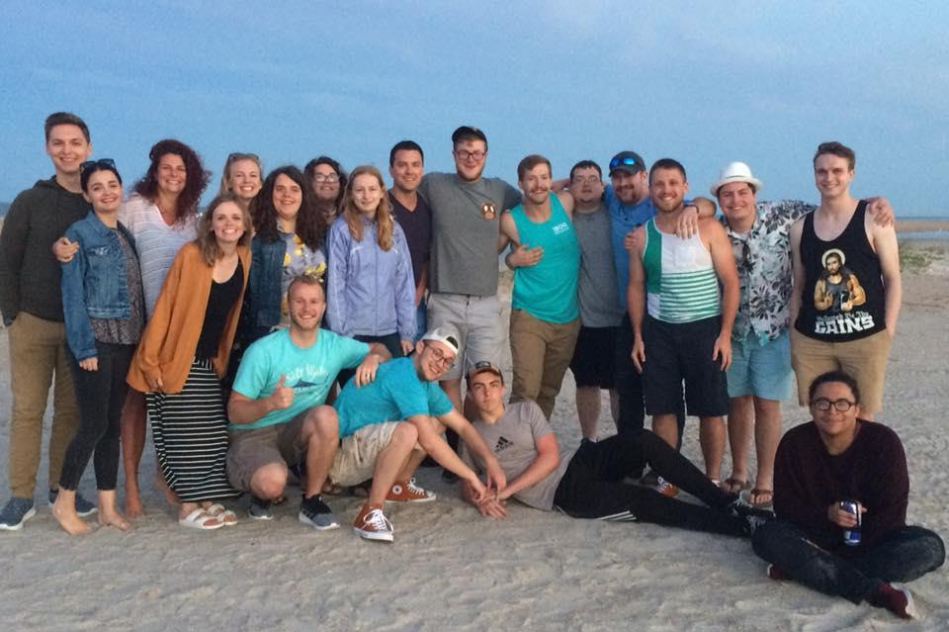
NOVA
DMT 2019

Slide 27
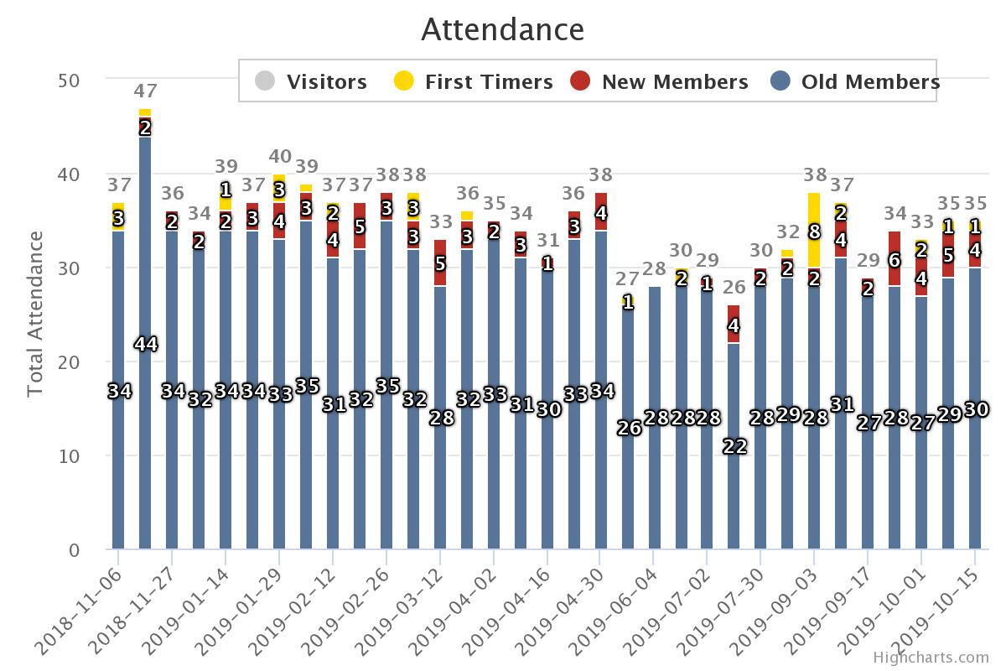
STATS
NOVA

Slide 28
STATE OF THE UNION
NOVA
LOSES
Spiritual attack!
Kicked out of / leaving apts
Thinking of leaving
Entire cell group nearly wiped out
Deacons under attack
New converts leaving (4/10)
“2nd decision” difficulties
Moved Joe to help other cell
People moving to other HCs (2x)
WINS
10 Salvations
Service ministries (11 ppl)
Ministry Apt Move-ins! (4x)
Deacon-team unity
Tarter Marriage
Theologian / Scholar (Adam)
We got 3 puppers
Notes:
The lord gave a shot in the arm to start, but then said “time to start growing up” → salvations came to a halt and people started struggling or just flat out failing/leaving

Slide 29
CHALLENGES
NOVA
Reluctance to suffer / mature
Salvations stalled
Reproductive discipleships
Raising next gen leaders
Nick Rajcsak
Corey & Alyssa
Teaching competency
Familial struggles
Notes:
The lord gave a shot in the arm to start, but then said “time to start growing up” → salvations came to a halt and people started struggling or just flat out failing/leaving

Slide 30
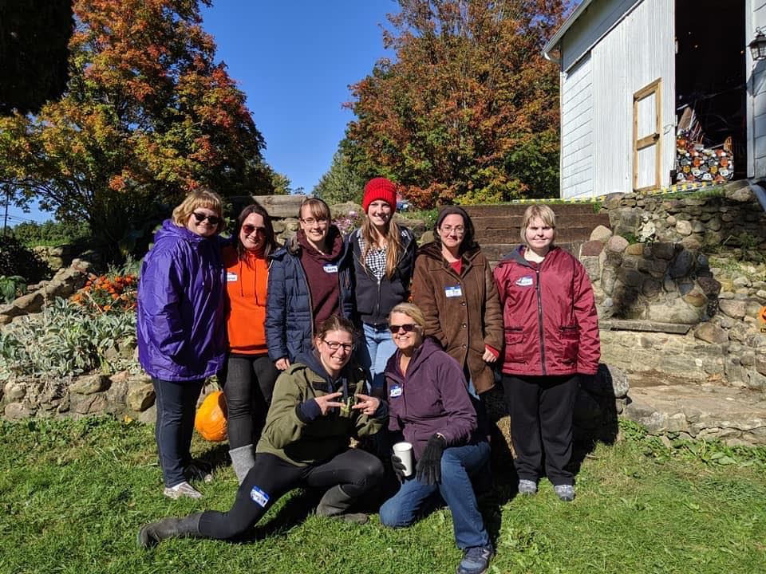
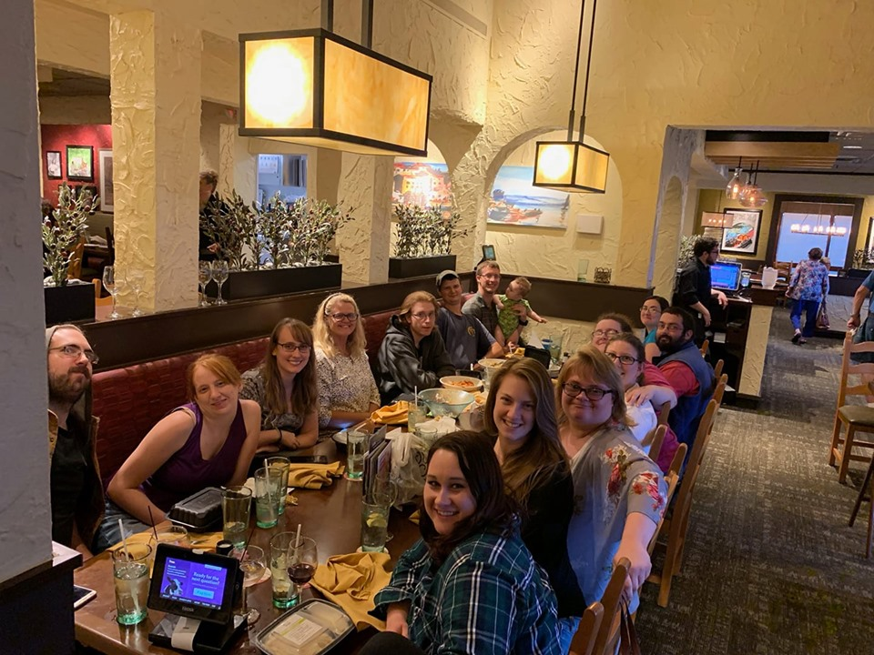
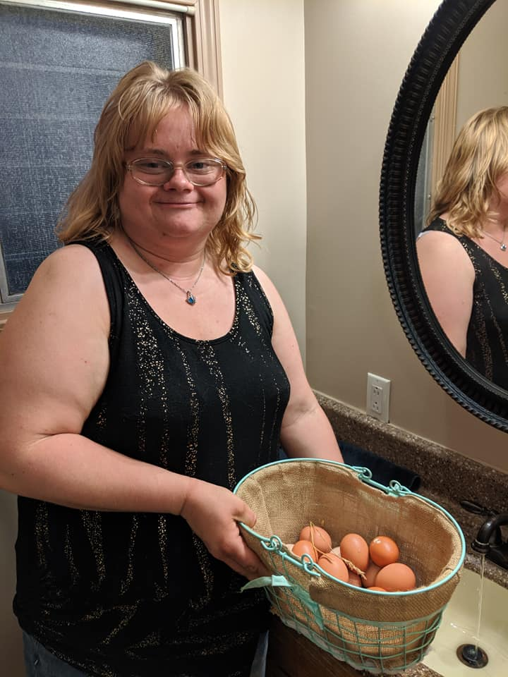
S.A.G.E. (Serving and Growing Experience)
Adapted young adult Bible study

Slide 31

The experience
Meetings are at the Helping Hands Farm
Meetings happen every other week, with a focus on discipleship and 1:1 hangouts off weeks
Meetings consist of pizza & snacks, adapted Bible study, then farm activities

Slide 32
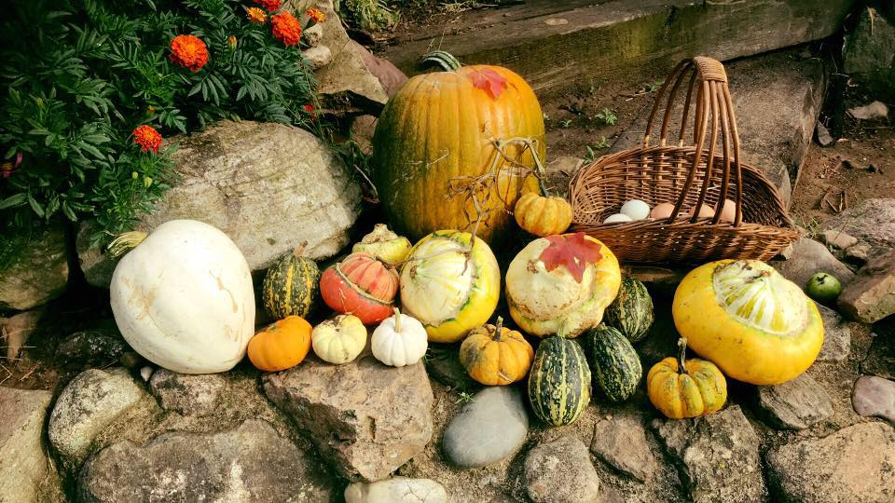
Average attendance: 6 people who don’t go to another homechurch,
2 First timers in the last 4 meetings
Workers: Emily F., Hannah I., Brandi B., Dan W., Seth B., Josh R.
Leaders: Indre, Laura, Schiffers

Slide 33
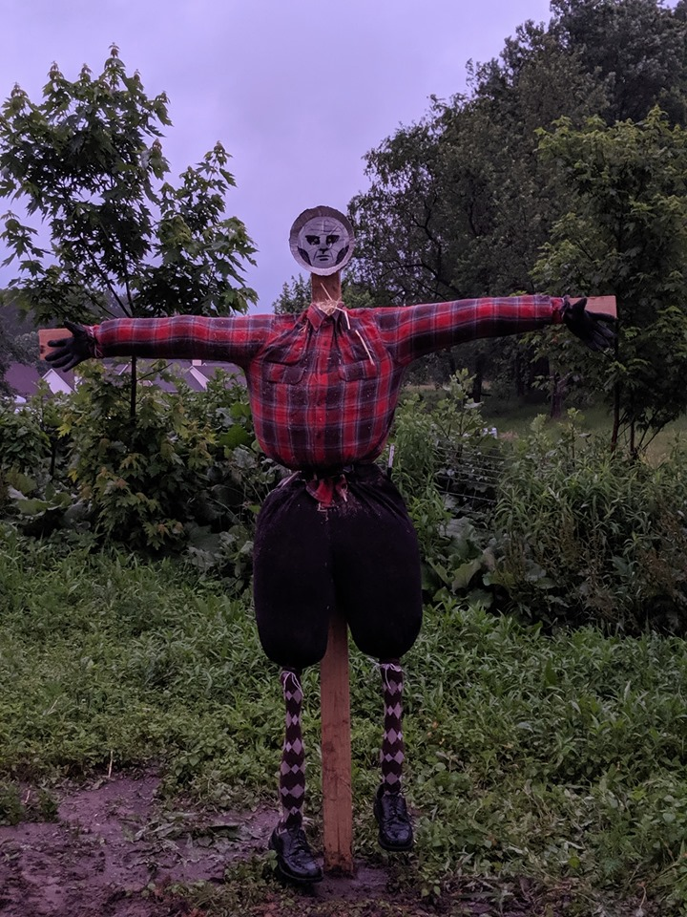
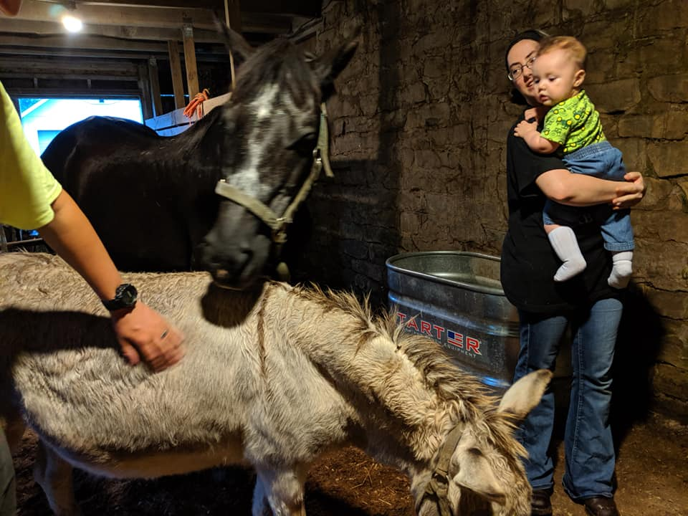
Wins
Losses
Bryan, Liz & Eddy Hodgeman
Rachel Tyson
Brittany
CCS Students on Kent’s campus

Slide 34

Upcoming Challenges
Passing on hope to our new members who are struggling (family loss, anxieties, jobs)
Getting our new members firmly rooted in God’s truths
Consistent attendance
Building our 1:1 relationships
Activities for winter time
Prayer Requests
More Helping Hands Farm employees (1 new hire = Emily F.)

Slide 35
Smash

Slide 36
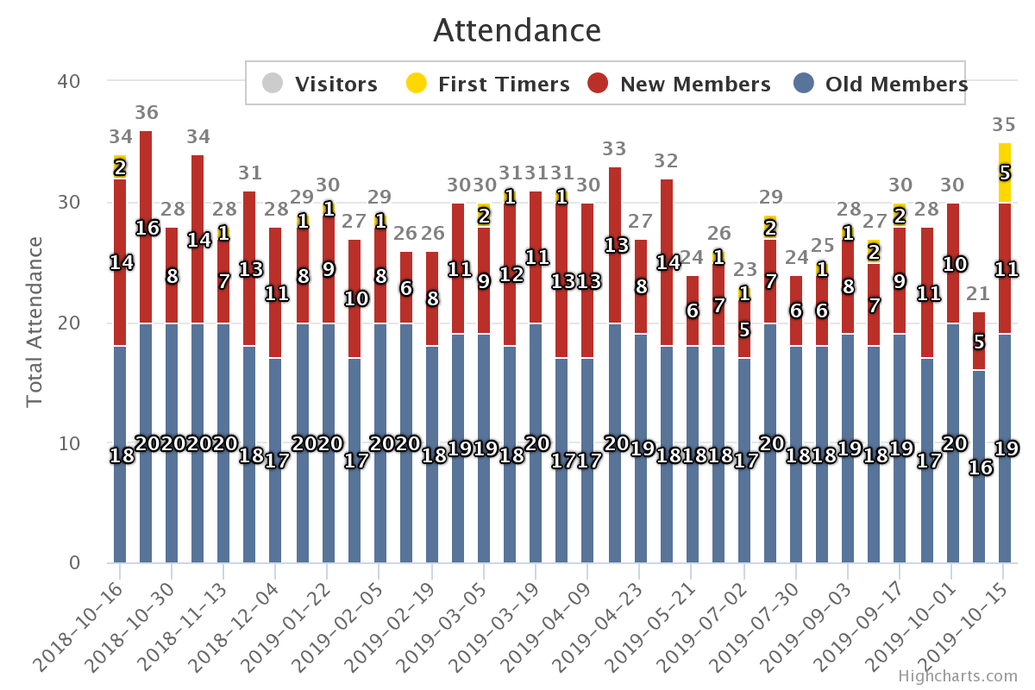

Slide 37
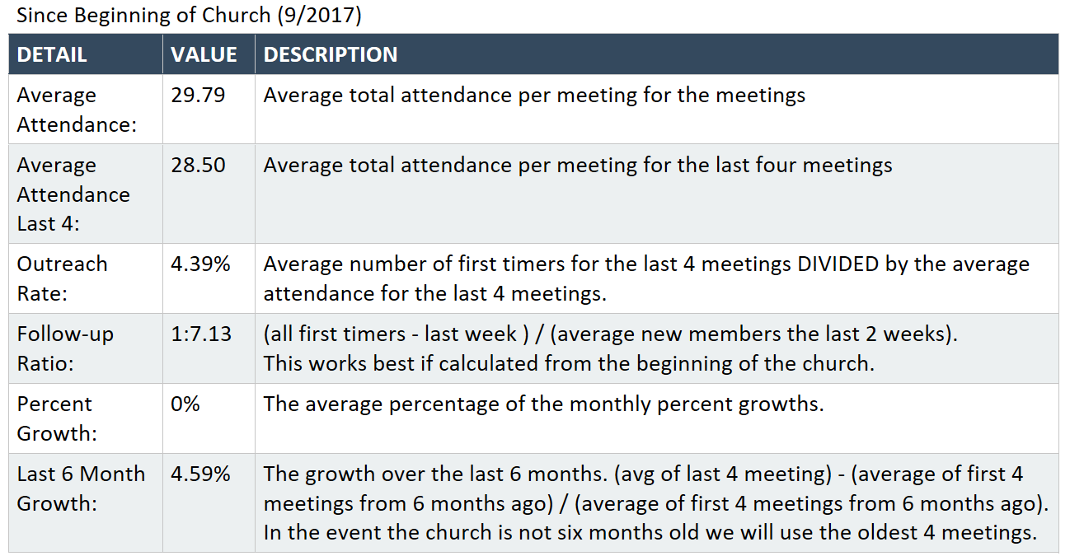
Notes:
Explanation of stats
Outreach: 4.4%
Follow-up is 1/7
4.6% growth in the last 6 months

Slide 38
Wins/Losses
Wins
Split guys ministry house. 4 new guys moved in
Raised up teachers
6 baptisms
Shane came back (and brought Megan with him)
Service ministries increasing (Big Brothers, True North, Joni & Friends)
Great meeting room in Cartwright Hall
Losses
One person moved out, another planning to move out.
Lost another potential bridge
Only able to win 2 of original 7 outreach group from Fall 2018

Slide 39
Upcoming Challenges
Spiritual conversations with follow-up
Dealing with immaturity
Single mom!
"Too old to do college ministry" mentality is creeping in with some
Many students graduating this year
Getting newer believers grounded

Slide 40
Stout 2019 DMT

Slide 41
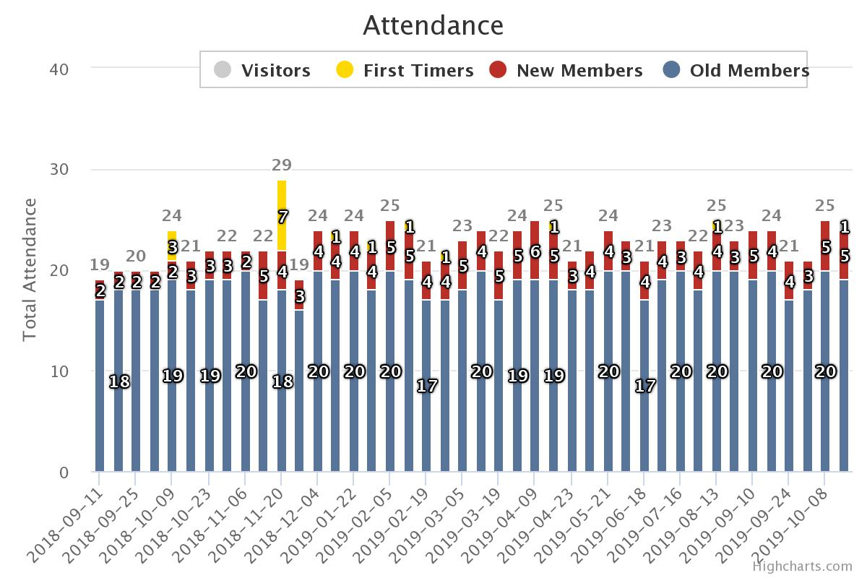
Average Attendance: | 22.81
Average Attendance Last 4: | 23.00
Outreach Rate: | 0%
Follow-up Ratio: | 1:3.20
Percent Growth: | 2%
Last 6 Month Growth: | 2.22%

Slide 42
STOUT
Explanation of stats
23 people per meeting
Growth of 3 people in the last year (2% growth per month)
2 salvations
16 first timers
Past years wins and losses
2 salvations -one Iranian (from Smash)
Discipline -weight loss, personal time in word
Meeting a lot of people- neighbors, running club, softball, old high school friends
12 people in service ministry (and 3 went to Joni and friends)
Marriages are generally flourishing
No significant losses
Upcoming challenges
Getting our friends in the community to come to a HC instead of just parties- having intentional conversations
Improve prayer meeting- it has become dull
Baby time

